Slide 1
AI and Ethics

Slide 2


What is AI in My Life?
Workshop series on Artificial Intelligence
Developed by ADAPT research centre and partners
Designed to help students navigate the ’Age of AI’
Our Partners:
This work is licensed under a Creative Commons Attribution-NonCommercial-ShareAlike 4.0 International License
Notes:
It was developed by the Science Foundation Ireland ADAPT Research Centre
ADAPT is a major academia-industry research centre with more than 300 researchers from 8 Irish universities (led by Trinity College Dublin and Dublin City University) producing research and innovations in many aspects of AI
Partners on the project include, for example, DCU Access, Amazon Web Services and the Lero software research centre
AI is transforming life as we know it. While AI offers substantial benefits to individuals and society, it has major implications for privacy, ethics and security. AI in My Life aims to help students navigate this so-called ‘Age of AI’ safely and successfully

Slide 3
What you’ll learn today
Learn about AI and how it’s used
Uncover some of the ethical and privacy implications of AI
Evaluate the role of AI in your life and in society
Our Partners:
This work is licensed under a Creative Commons Attribution-NonCommercial-ShareAlike 4.0 International License

Slide 4
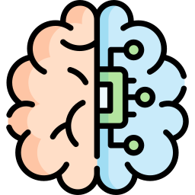
What is AI?
Artificial intelligence refers to many different technologies that are designed to accomplish tasks that can otherwise be only carried out by human minds, for example identifying patterns, recognising images, understanding languages or solving problems.
This work is licensed under a Creative Commons Attribution-NonCommercial-ShareAlike 4.0 International License
Notes:
Comprehend = understand
Sense = detect
Through AI, we can programme machines to plan, learn, reason, solve problems, and make decisions.

Slide 5
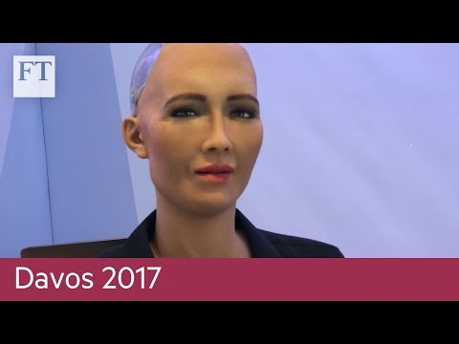
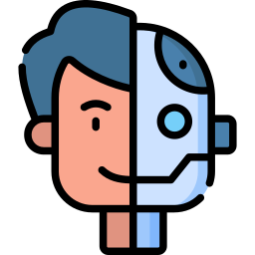
Ethics and AI
This work is licensed under a Creative Commons Attribution-NonCommercial-ShareAlike 4.0 International License

Slide 6
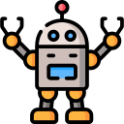
Let’s start
What do we mean by “ethics”?
This work is licensed under a Creative Commons Attribution-NonCommercial-ShareAlike 4.0 International License

Slide 7
What do we mean by “ethics”?
Our understanding of what is right and wrong, as well as the rules that individuals and the society should follow.
This work is licensed under a Creative Commons Attribution-NonCommercial-ShareAlike 4.0 International License

Slide 8
What do we mean by “AI ethics”?
AI ethics refers to the moral principles and values that should guide the development and use of artificial intelligence systems.
AI systems should be designed and used in a way that benefits society and follows ethical principles.
Issues like fairness, transparency, privacy and safety are important ethical considerations.
This work is licensed under a Creative Commons Attribution-NonCommercial-ShareAlike 4.0 International License

Slide 9

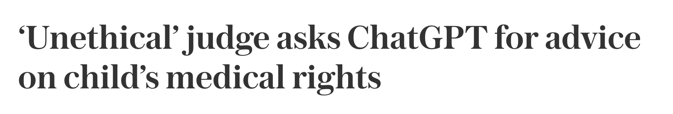

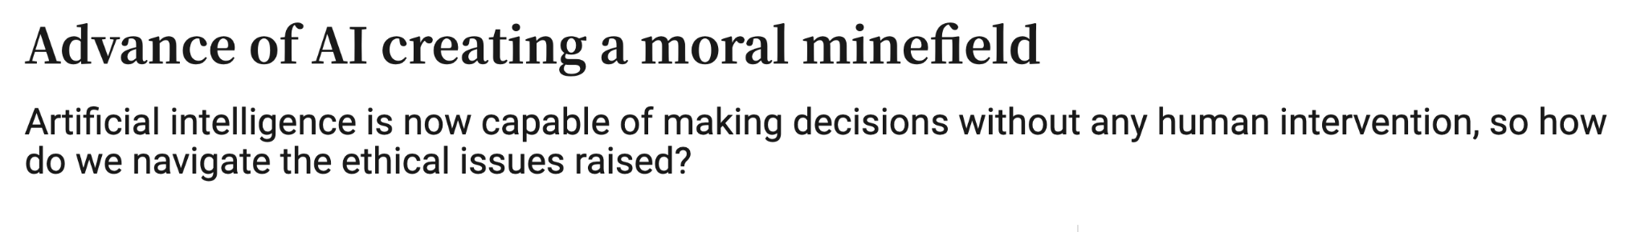

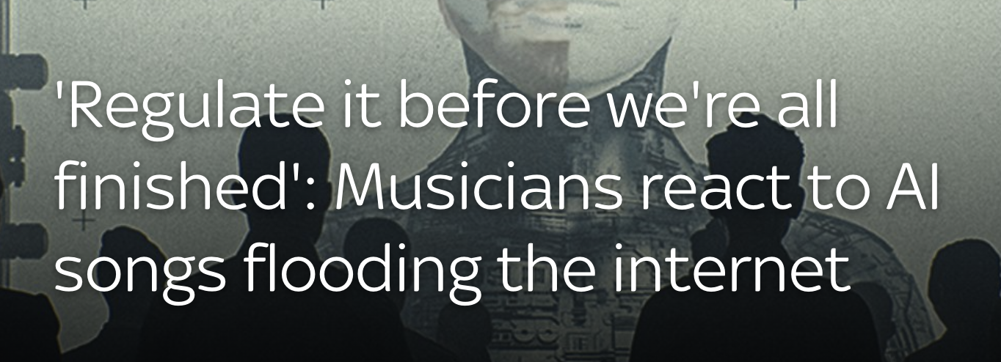
Why does ethics matter for AI?
s
The ethics of using generative AI to create journalism: What we know so far
This work is licensed under a Creative Commons Attribution-NonCommercial-ShareAlike 4.0 International License

Slide 10

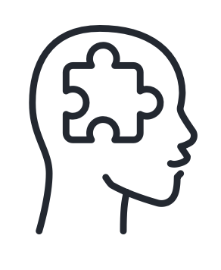

Why does ethics matter for AI?
AI has the potential for immense impact, both positive and negative.
AI systems are increasingly being entrusted with high-stakes decisions that affect human lives and society.
AI learns from data, which can encode human biases and prejudices. Unethical applications could automate or worsen injustice.
This work is licensed under a Creative Commons Attribution-NonCommercial-ShareAlike 4.0 International License

Slide 11


Why does ethics matter for AI?
As AI gets more capable and autonomous, we need to maintain human accountability and control.
Ethical issues around AI use, like privacy invasion or job losses, require careful consideration to avoid public backlash.
Ethics helps ensure AI development and use is guided in a socially responsible direction.
This work is licensed under a Creative Commons Attribution-NonCommercial-ShareAlike 4.0 International License

Slide 12
What rules would you consider?
You are given the task of creating a set of rules for a scientist who is creating an AI bot.
This work is licensed under a Creative Commons Attribution-NonCommercial-ShareAlike 4.0 International License

Slide 13



Ethical Considerations for AI Development (1 of 2)
Privacy and Data Governance
There are strict rules about people's data and how AI is able to use it.
Technical Robustness and Safety
AI tools do not contain errors and their operation does not lead to harm.
Human Agency and Oversight
All decisions are reviewed by humans and humans are the “in charge” of final decisions.
This work is licensed under a Creative Commons Attribution-NonCommercial-ShareAlike 4.0 International License

Slide 14




Ethical Considerations for AI Development (2 of 2)
Diversity, Non-Discrimination and Fairness
AI should work equally well for different people and in different contexts. The benefits of AI should be shared equally.
Societal and Environmental Well Being
AI should impact the environment and the society in a positive way.
Transparency
It is possible to say what decisions AI makes, what steps led it to those decisions and what data informed them.
Accountability
We know who is responsible for the AI and we can fix problems or enforce sanctions when something goes wrong.
This work is licensed under a Creative Commons Attribution-NonCommercial-ShareAlike 4.0 International License

Slide 15


Scenario A: ChatGPT and school assignments
https://www.youtube.com/watch?v=Fn8jDanbf0c
This work is licensed under a Creative Commons Attribution-NonCommercial-ShareAlike 4.0 International License

Slide 16
Questions for Scenario A
Should you ask AI to help with your homework?
How is this different to working with other (real) people or asking a parent, sibling, or friend for help?
How can we establish trust between students and teachers in a world where AI tools like ChatGPT exist?
This work is licensed under a Creative Commons Attribution-NonCommercial-ShareAlike 4.0 International License

Slide 17
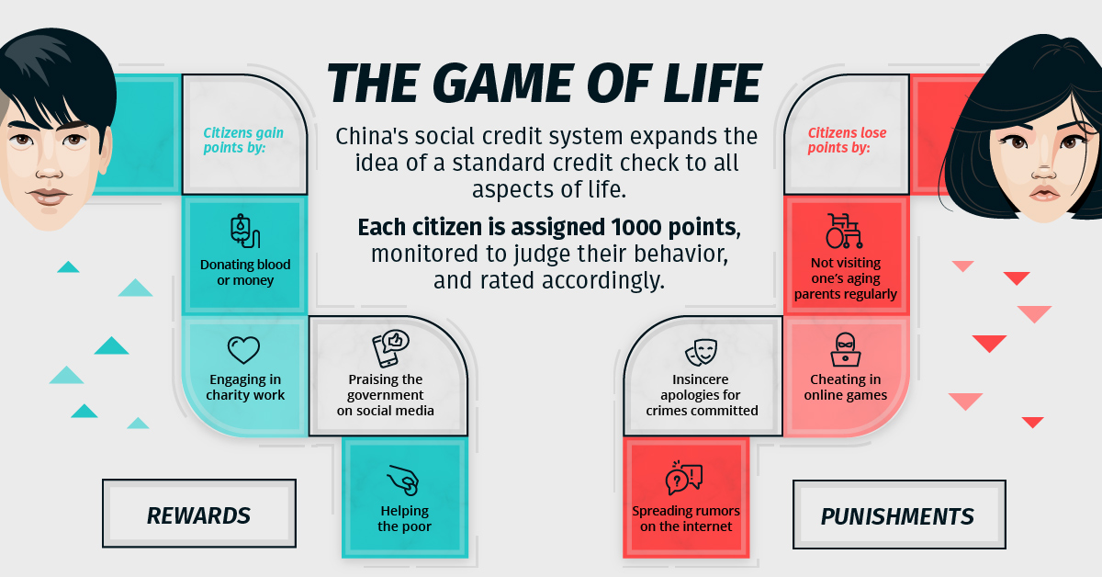
Scenario B China’s Social Credit System
China's social credit system keeps a critical eye on everyday behavior - YouTube
This work is licensed under a Creative Commons Attribution-NonCommercial-ShareAlike 4.0 International License

Slide 18
Questions for Scenario B
Within months of early trials of this system being launched in 2014, more than 14 million people opted in. Why do you think this is?
How would you feel about such a system being introduced in Ireland? Would you opt in?
Should researchers (in universities or in companies) have to consider the potential uses to which the innovations they develop might be put? Should they be held accountable?
This work is licensed under a Creative Commons Attribution-NonCommercial-ShareAlike 4.0 International License

Slide 19
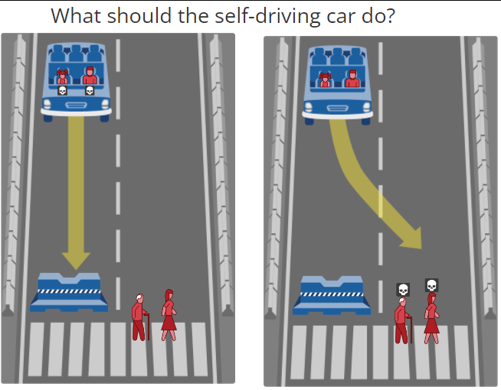
Ethical Decisions of AI
The self-driving car with sudden brake failure will continue ahead and crash into a barrier killing a middle aged man and his young daughter
The self-driving car with sudden brake failure will continue ahead and crash into a barrier killing an elderly man and a middle aged woman
https://www.moralmachine.net
This work is licensed under a Creative Commons Attribution-NonCommercial-ShareAlike 4.0 International License

Slide 20
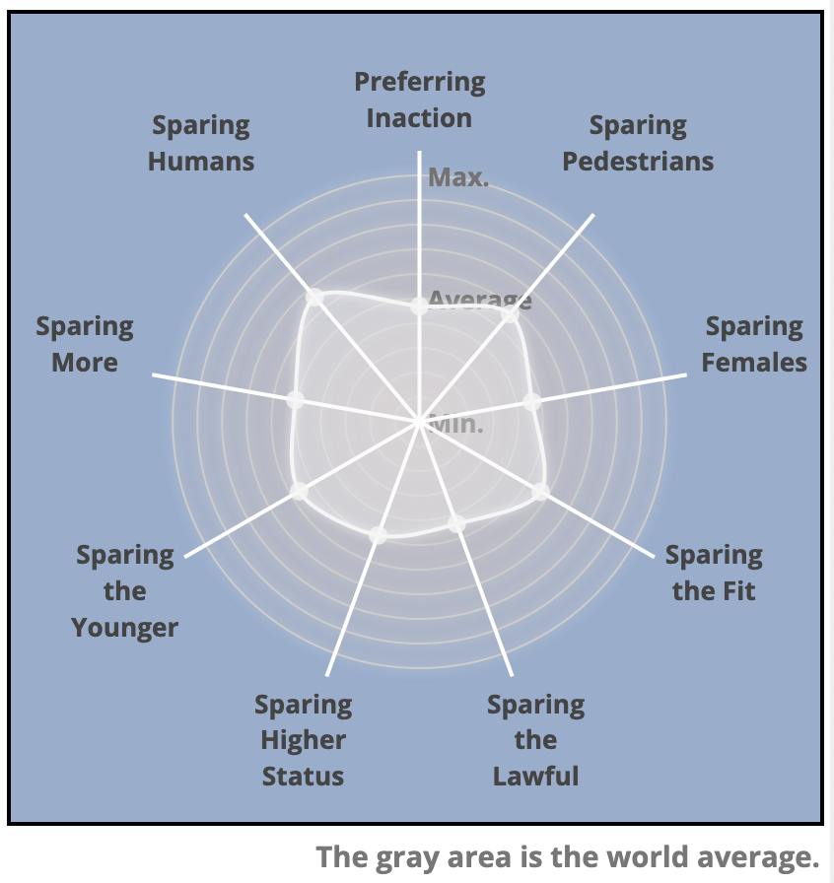
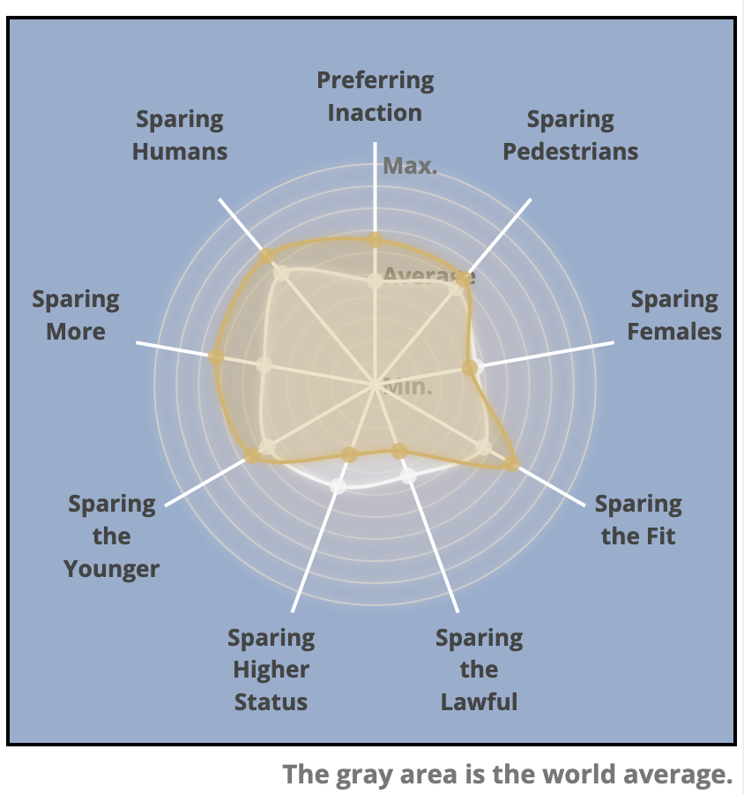
Ethical Decisions of AI: How does Ireland compare?
The grey area is the world average
The grey area is the world average
The yellow area is the average of responses from Ireland
https://www.moralmachine.net
This work is licensed under a Creative Commons Attribution-NonCommercial-ShareAlike 4.0 International License

Slide 21
Ethical Decisions of AI: How does Ireland compare?
How contributions from Ireland compare to other countries
https://www.moralmachine.net
This work is licensed under a Creative Commons Attribution-NonCommercial-ShareAlike 4.0 International License

Slide 22
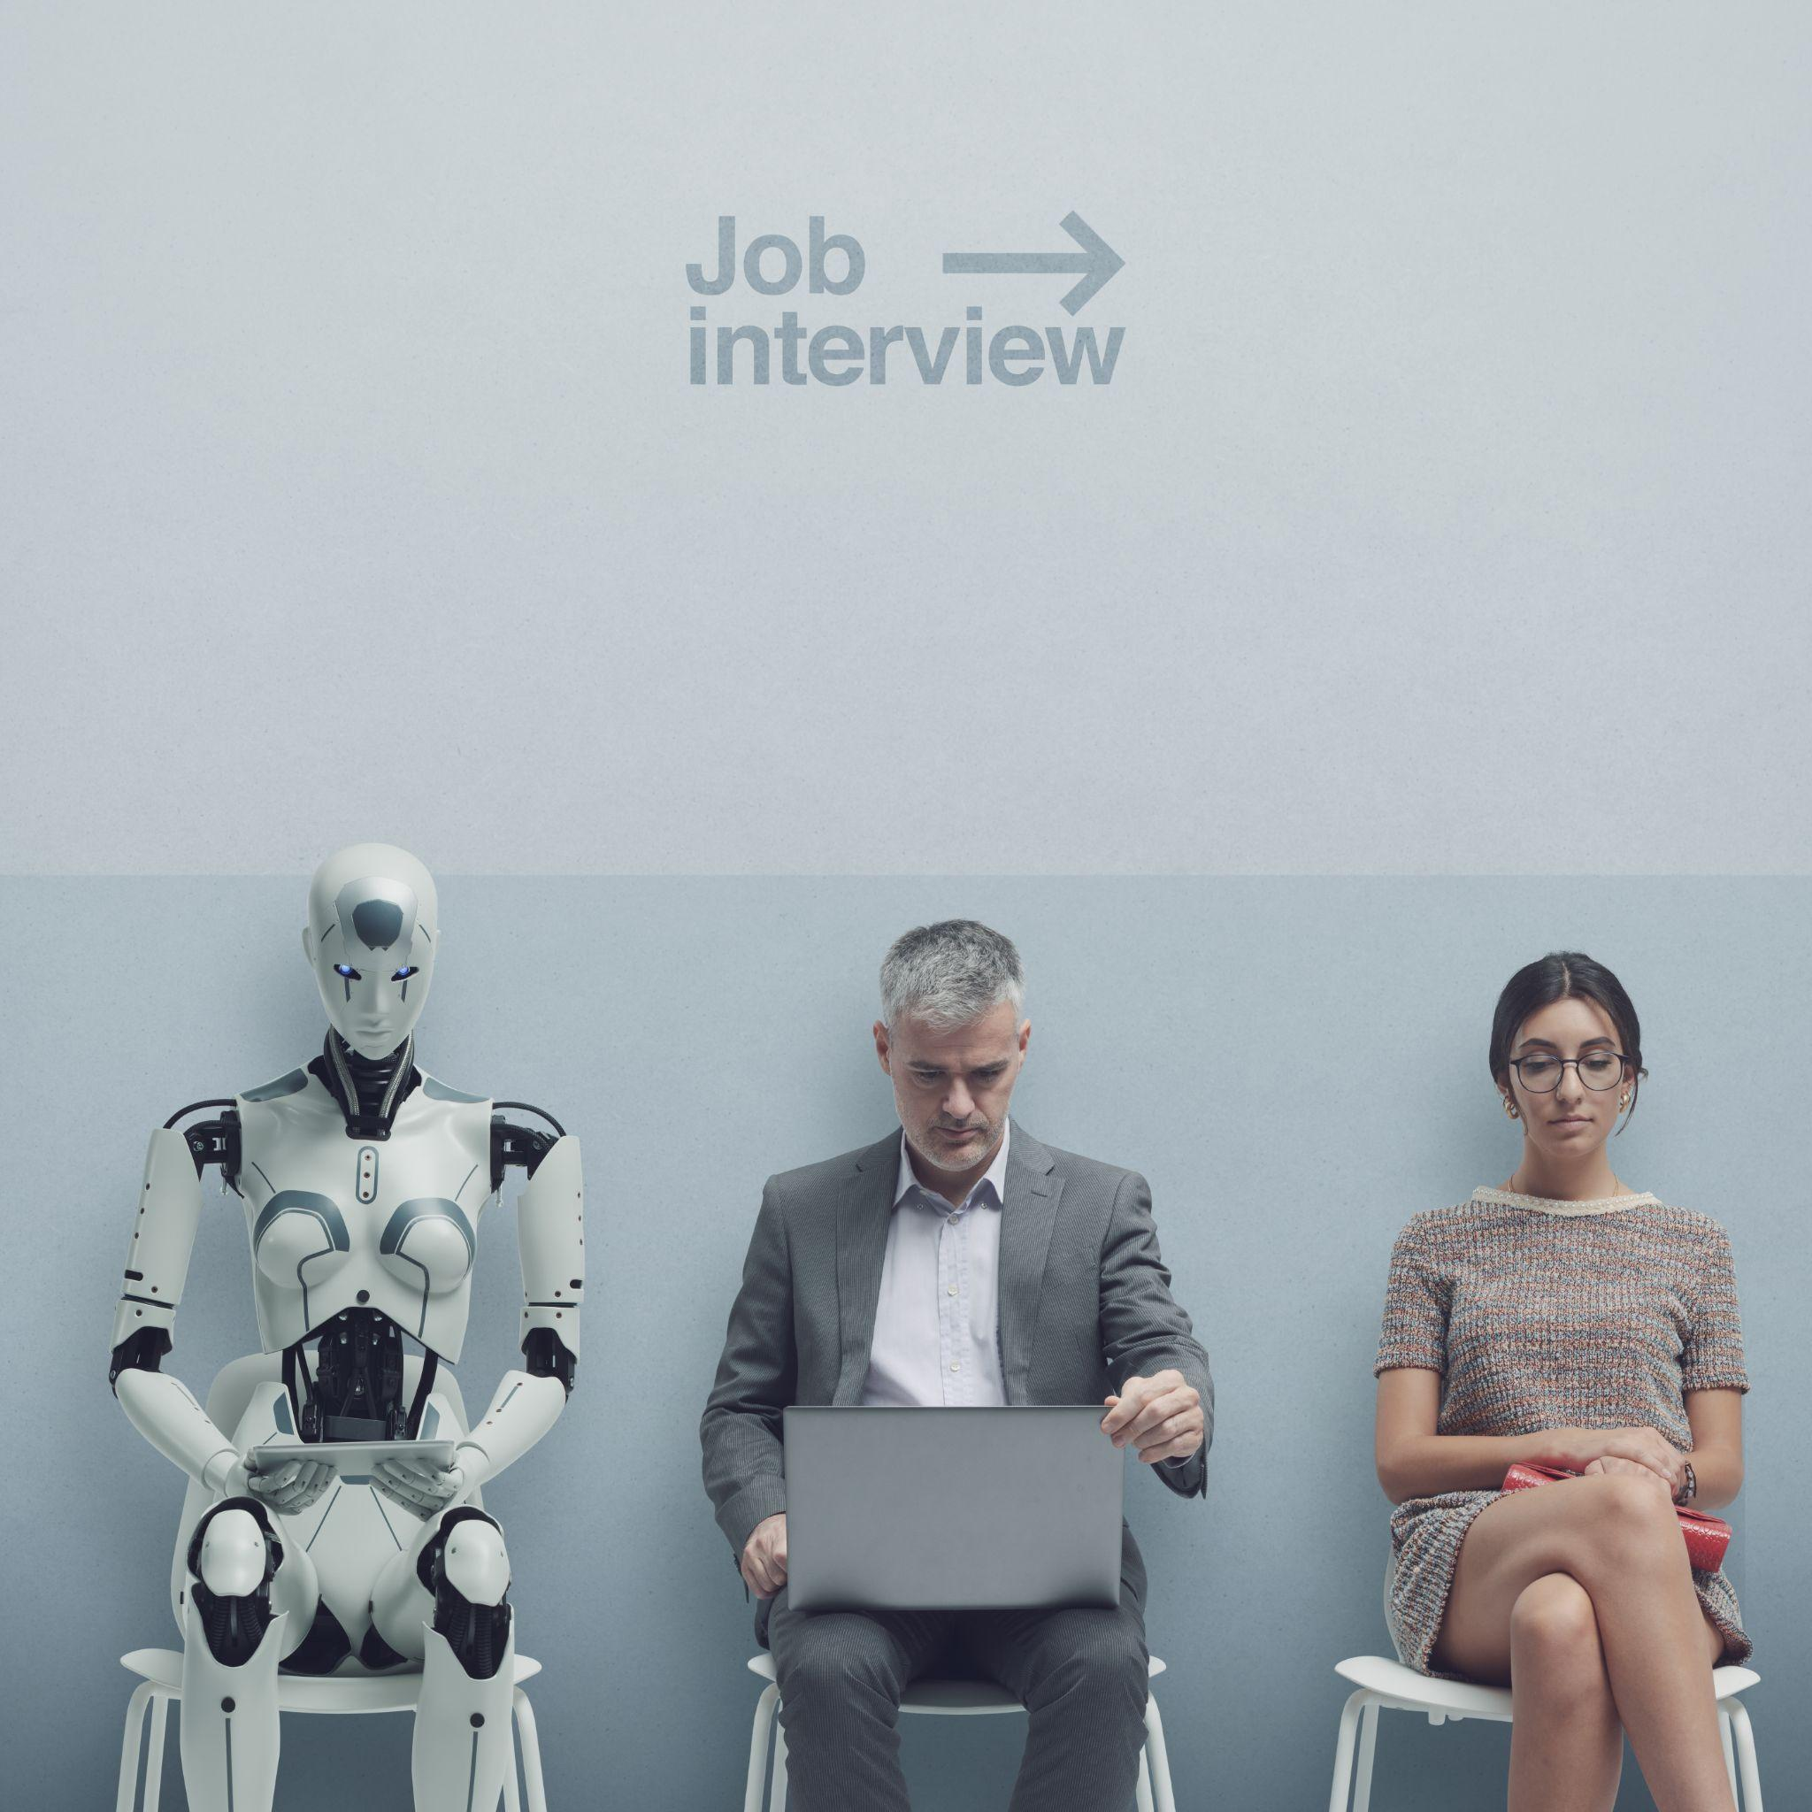
Will we all be able to find work in a world with AI?
Automation is often seen as a threat to manual labour. Robots replace factory workers and farmers, while self-driving cars come after human drivers’ jobs.
But AI is also trained to perform more intellectual tasks such as translation, programming, writing, medical diagnosis or teaching.
How do we make sure that entire professions do not disappear and that we all have a chance at meaningful employment and a decent standard of living?
This work is licensed under a Creative Commons Attribution-NonCommercial-ShareAlike 4.0 International License

Slide 23

What about the impact of AI on our planet?
The data used by AI is stored and processed in enormous data centres, each made up of millions of servers and computers.
In 2022, data centres accounted for 18% of Irish energy consumption. That’s going to grow as our use of AI increases.
As the servers require cooling, it is estimated that ChatGPT uses half a litre of water for every 5 to 50 prompts it answers!
Minerals and metals used to manufacture the servers are mostly found in developing countries, but their extraction is destructive to the environment and dangerous to the local population.
Can we justify the rapid expansion of AI in the middle of a climate crisis?
Is it possible to produce the necessary equipment in a sustainable and fair way?
This work is licensed under a Creative Commons Attribution-NonCommercial-ShareAlike 4.0 International License

Slide 24
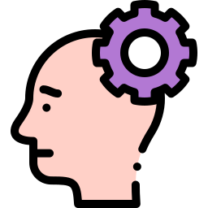
Questions to consider
Who should be blamed when decisions made by AI lead to harm?
What are the differences between the rules that should apply to ethical AI and those that govern our own ethical behaviour?
To what extent can we ignore the risks of AI to enjoy the benefits it provides?
What can we do as citizens to influence how AI is used?
This work is licensed under a Creative Commons Attribution-NonCommercial-ShareAlike 4.0 International License

Slide 25
What have we learned?
AI presents important ethical questions
Those developing AI need
to think and act ethically
Our use of AI also needs
to be ethical
It is vital for us to balance the advantages and disadvantages of AI
This work is licensed under a Creative Commons Attribution-NonCommercial-ShareAlike 4.0 International License
Notes:
Ask students to indicate what are their key takeaways from this lesson?

Slide 26
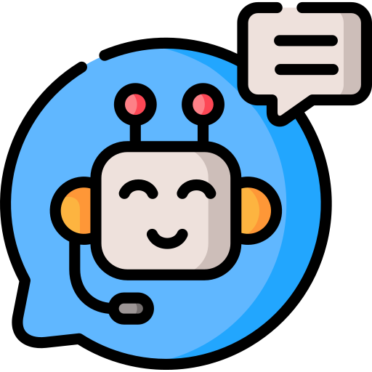
Thanks to our partners:
Want to find out more about AI?
Sign up for more AI in My Life modules at:
www.adaptcentre.ie/projects/ai-in-my-life/

